Slide 1


BLOCKCHAIN-BASED
CRIMINAL INFORMATION
MANAGEMENT SYSTEM
IN SRI LANKA
GROUP ID: TMP-23-270

Slide 2

TABLE OF
CONTENT
01
OVERALL PROJECT DESCRIPTION
02
IT20150952
SMART CONTRACT FOR BLOCKCHAIN
03
IT20171438
AUTHENTICATION SYSTEM
04
IT20157814
SECURE FILE MANAGEMENT SYSTEM
05
IT19983370
ACCESS CONTROL SYSTEM
06
REFERENCES

Slide 3

OVERALL PROJECT DESCRIPTION
Project Details;
Project ID: TMP-23-270
Supervisor: Mr. Kanishka Yapa
Co-Supervisor: Ms. Dinithi Pandithage

Slide 4

RESEARCH PROBLEM
Lack of integration
Inconsistent data quality
Privacy and Security Concern
Insufficient Process
Lack of transparency

Slide 5
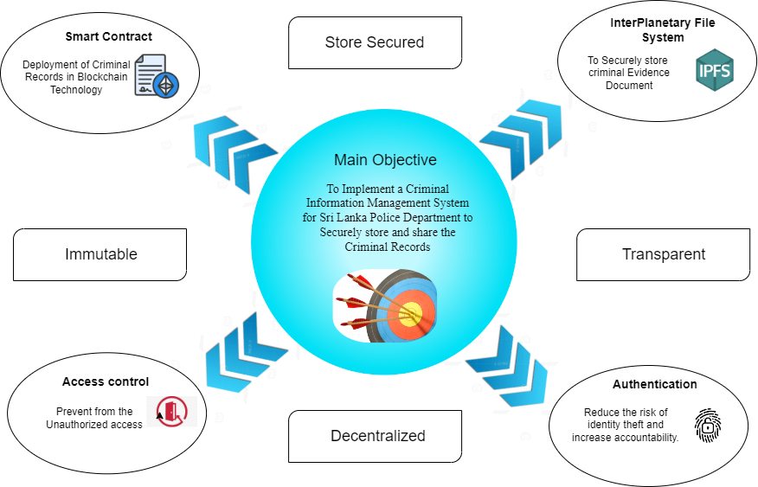
OBJECTIVES

Slide 6
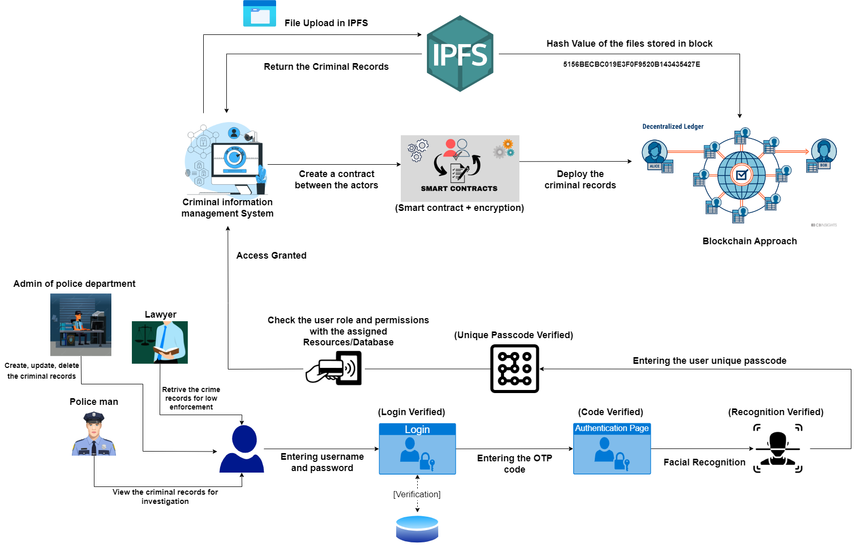
OVERALL SYSTEM DIAGRAM

Slide 7

IT20150952 | BRAHANAWARDHAN B.
Student’s Specialization - Cyber Security
IT20150952 | <<Brahanawardhan B.>> | <<TMP-23-270>>

Slide 8

INTRODUCTION
IMPLEMENTING SMART CONTRACT IN CRIMINAL INFORMATION MANAGEMENT USING BLOCKCHAIN TECHNOLOGY
Current state of criminal information Management system in Sri Lanka.
Introducing Blockchain technology in our Criminal Information Management system in Sri Lanka.
Key features and benefits of blockchain based criminal information management system.
Immutable records
Efficiency of criminal Records
Data Privacy
Ensure Confidentiality, Availability and Integrity.
IT20150952 | <<Brahanawardhan B.>> | <<TMP-23-270>>

Slide 9
RESEARCH PROBLEM
RESEARCH PROBLEM
INTEROPERABILITY
SCATTERED CRIMINAL RECORDS
HAND FILL DOCUMENTS
INTEGRITY PROBLEM
LOCAL DATABASES
IT20150952 | <<Brahanawardhan B.>> | <<TMP-23-270>>

Slide 10
RESEARCH GAP
CONSIDERATION ON | EXISTING LOCAL DATABASE BASED CRIMINAL MANAGEMENT SYSTEM IN SRI LANKA | BLOCKCHAIN TECHNOLOGY FOR CRIMINAL INFORMATION MANAGEMENT SYSTEM
Security of Sensitive Criminal Records | LOW | HIGH
Decentralization Of System | LOW | HIGH
Ensure data Integrity | LOW | HIGH
Prevent loss of data | LOW | HIGH
Availability | LOW | HIGH
Confidentiality | LOW | HIGH
IT20150952 | <<Brahanawardhan B.>> | <<TMP-23-270>>

Slide 11

RESEARCH QUESTION
How can the implementation of smart contracts in a blockchain-based criminal information management system improve the efficiency, transparency, and security of criminal investigations in sri Lanka Criminal Information Management system ?
IT20150952 | <<Brahanawardhan B.>> | <<TMP-23-270>>

Slide 12

SPECIFIC OBJECTIVES
Increased efficiency, transparency, and security of Criminal Records.
Ensure Confidentiality, Integrity, Availability.
Reduce the lack of consistency.
Increase the performance and usability of criminal Records.
IT20150952 | <<Brahanawardhan B.>> | <<TMP-23-270>>

Slide 13
SUB OBJECTIVES
Identify the current CIMS in Sri Lanka and limitation.
Review the literature on smart contracts.
Conduct a feasibility study
Identify the stakeholders
Develop a prototype
Recommendations and guidelines
IT20150952 | <<Brahanawardhan B.>> | <<TMP-23-270>>

Slide 14
METHODOLOGY
Research Design
Data Collection: Collecting Criminal Records
Blockchain technology Evaluation
Smart contract Design
Legal and Regulatory Framework Evaluation.
Implementation
IT20150952 | <<Brahanawardhan B.>> | <<TMP-23-270>>

Slide 15
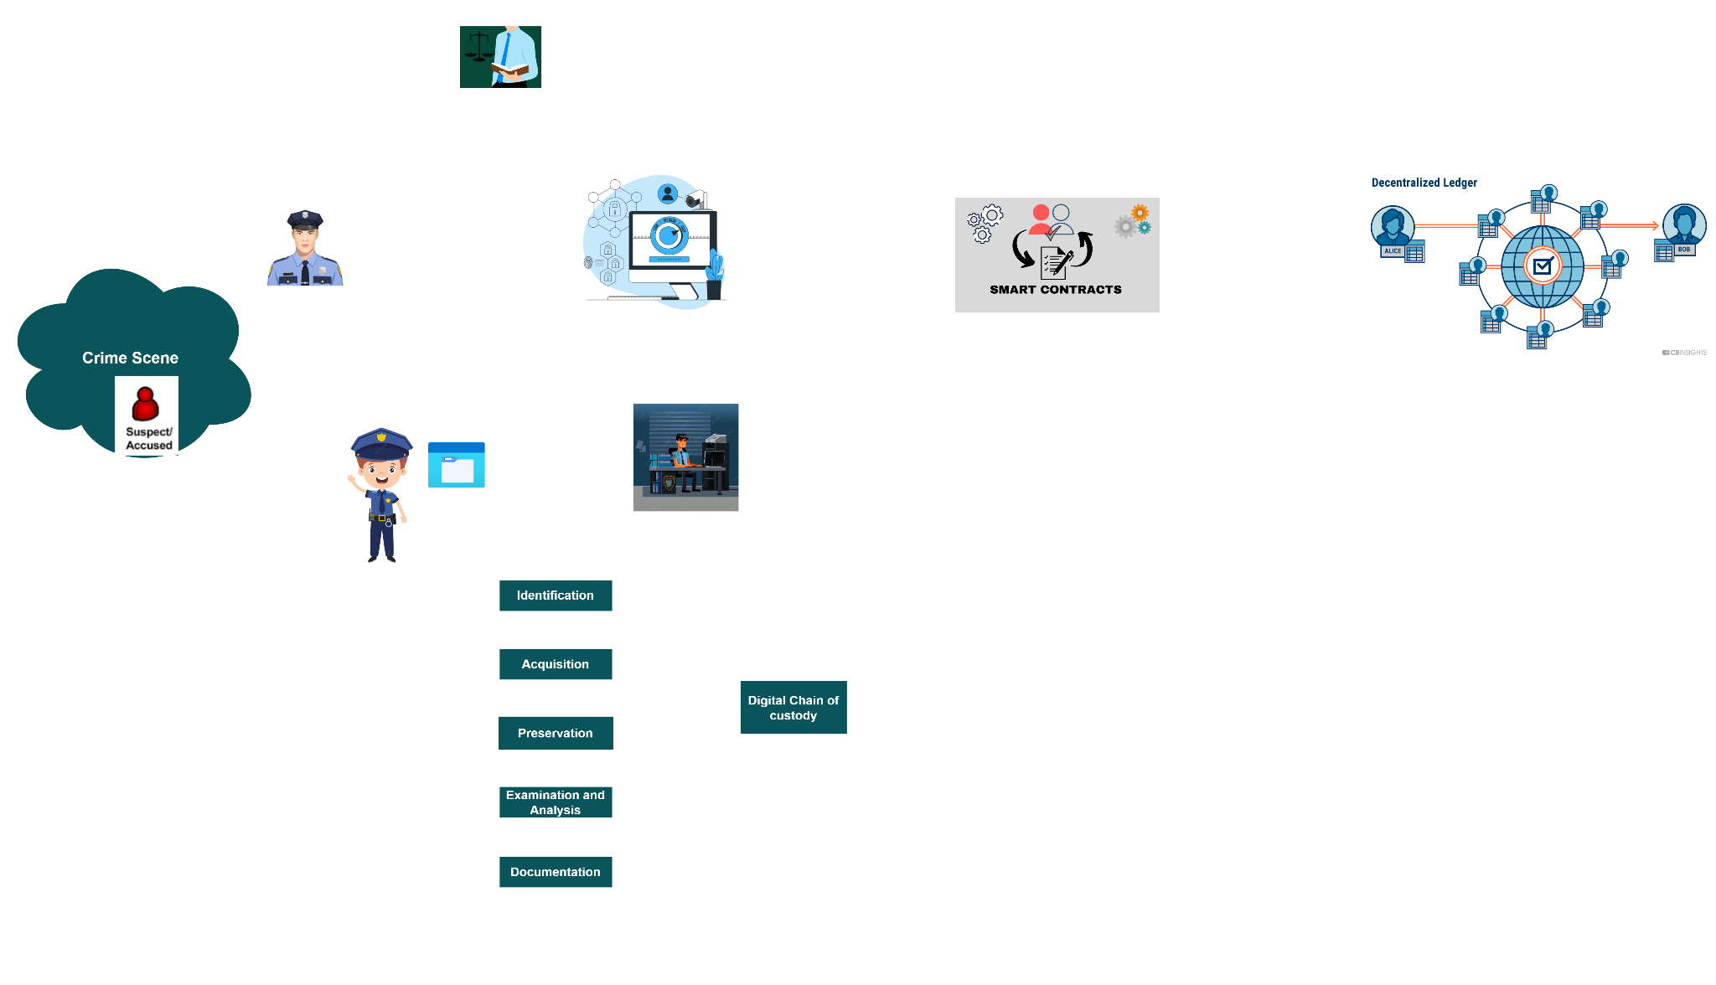
SYSTEM OVERVIEW DIAGRAM
IT20150952 | <<Brahanawardhan B.>> | <<TMP-23-270>>

Slide 16
REFERENCES
IT20150952 | BRAHANAWARDHAN B.
[1] “Blockchain-based Criminal Record Database Management.” [Online]. Available: https://ieeexplore.ieee.org/document/9544655. [Accessed: 19-Mar-2023].
[2] “Crab: Blockchain based Criminal Record Management System.” [Online]. Available: https://www.researchgate.net/publication/329489346_CRAB_Blockchain_Based_ Criminal_Record_Management_System. [Accessed: 19-Mar-2023].
[3] “Blockchain-based Criminal Record Database Management.” [Online]. Available: https://ieeexplore.ieee.org/document/9544655. [Accessed: 19-Mar-2023].
[4] Wust, K., Gipp, B., & Breitenbücher, U. (2018). “Blockchain in forensic science: Securing digital evidence”. In 2018 41st International Convention on Information and Communication Technology, Electronics and Microelectronics (MIPRO) (pp. 1350- 1355). IEEE.

Slide 17

IT20171438 | WIJAYARATHNE S. N.
Student’s Specialization - Cyber Security
IT20171438 | <<Wijayarathne S. N.>> | <<TMP-23-270>>

Slide 18



RESEARCH QUESTION
HOW TO SECURE SYSTEM LOGIN BY IMPLEMENTING A SECURE AUTHENTICATION SYSTEM TO THE BLOCKCHAIN-BASED CRIMINAL INFORMATION MANAGEMENT SYSTEM IN SRI LANKA?
Every system and application requires a user account.
Username
Password
Technological Improvement;
Brute Force Attacks
Phishing Attacks
Social Engineering Attacks
Etc.
As an additional layer; Two-Factor Authentication System (2FA) was introduced.
1FA (1st Factor)
IT20171438 | <<Wijayarathne S. N>> | <<TMP-23-270>>

Slide 19



2FA SECURE? Can 2FA be HACKED?
SIM Swapping
Security analysis of SMS as a second factor of authentication [1].
SIM Cloning
A novel Two-Factor HoneyToken Authentication Mechanism [2].
Man-in-the-Middle Attacks
How Anywhere Computing Just Killed Your Phone-Based Two-Factor Authentication [3].
Phishing Attacks
How to Attack Two-Factor Authentication Internet Banking [4].
As a solution and an additional layer of security: Inherence Factor Authentication
Fingerprint
Facial Recognition
Voice Recognition
3FA (3rd Factor)
IT20171438 | <<Wijayarathne S. N>> | <<TMP-23-270>>

Slide 20
RESEARCH GAP
CONSIDERATION ON | EXISTING SYSTEMS | PROPOSED SYSTEM
1ST FACTOR | Security Level is LOW | Security Level is HIGH
2ND FACTOR | Security Level is MODERATE | Security Level is HIGH
3RD FACTOR | Security Level is MODERATE | Security Level is HIGH
CONFIDENTIALITY | Security Level is LOW | Security Level is HIGH
INTEGRITY | Security Level is LOW | Security Level is HIGH
POSSIBLE OTP COMBINATIONS | LOW (59,049) | HIGH (60,466,176)
ARTIFICIAL INTELLIGENCE | NONE | IMPLEMENTED
OVERALL SYSTEM | Security Level is MODERATE | Security Level is HIGH
IT20171438 | <<Wijayarathne S. N>> | <<TMP-23-270>>

Slide 21
SPECIFIC OBJECTIVES
Proposed Authentication System ;
Three-Factor Authentication (3FA) System
Additional Layer of Security Implemented at the End.
The 1st Factor;
Username and Password
The 2nd Factor;
One-Time Password
The 3rd Factor;
Facial Recognition
Additional Layer of Security;
System Generated Unique Passcode
IT20171438 | <<Wijayarathne S. N>> | <<TMP-23-270>>

Slide 22
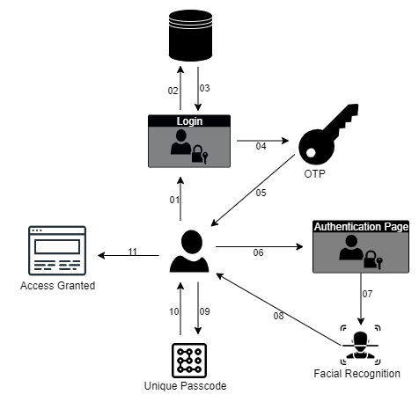
SYSTEM OVERVIEW DIAGRAM
01 – User entering Username & Password
02 – Entered Username & Password being checked
03 – Username & Password being verified
04 – Moving to the OTP page
05 – OTP code will be send to the client
06 – Entering the OTP code to the Authentication Page
07 – Moving to the Facial Recognition Page
08 – Facial Recognition Process
09 – User entering the Unique Passcode
10 – Verifying the Unique Passcode
11 – Access Granted to the System
IT20171438 | <<Wijayarathne S. N>> | <<TMP-23-270>>

Slide 23
METHODOLOGY
1st Factor;
Highest-level of Security Standards
Alerts Generated
Number of Attempts
2nd Factor;
6-Digit Code → 6-Character Code [59,049 → 60,466,176]
Number of Attempts
Time Restriction
3rd Factor;
AI Trained Algorithm
Number of Attempts
Additional Layer of Security;
Unique System Generated Code
Code Expiration
IT20171438 | <<Wijayarathne S. N>> | <<TMP-23-270>>

Slide 24
REFERENCES
IT20171438 | WIJAYARATHNE S. N.
R. P. Jover, "Security analysis of SMS as a second factor of authentication," Commun. ACM, vol. 63, no. 12, p. 46–52, 17 November 2020, doi: doi.org/10.1145/3424260
V. Papaspirou, L. Maglaras, M. A. Ferrag, I. Kantzavelou, H. Janicke and C. Douligeris, "A novel Two-Factor HoneyToken Authentication Mechanism," 2021 International Conference on Computer Communications and Networks (ICCCN), Athens, Greece, 2021, pp. 1-7, doi: 10.1109/ICCCN52240.2021.9522319.
Konoth, R.K., van der Veen, V., Bos, H. (2017). How Anywhere Computing Just Killed Your Phone-Based Two-Factor Authentication. In: Grossklags, J., Preneel, B. (eds) Financial Cryptography and Data Security. FC 2016. Lecture Notes in Computer Science(), vol 9603. Springer, Berlin, Heidelberg. https://doi.org/10.1007/978-3-662-54970-4_24
Adham, M., Azodi, A., Desmedt, Y., Karaolis, I. (2013). How to Attack Two-Factor Authentication Internet Banking. In: Sadeghi, AR. (eds) Financial Cryptography and Data Security. FC 2013. Lecture Notes in Computer Science, vol 7859. Springer, Berlin, Heidelberg. https://doi.org/10.1007/978-3-642-39884-1_27

Slide 25

IT20157814 | AHMED M. N. H.
Student’s Specialization - Cyber Security
IT20157814 | <<Ahmed M. N. H.>> | <<TMP-23-270>>

Slide 26
INTRODUCTION
SECURE FILE MANAGEMENT SYSTEM IN DECENTRALIZED NETWORK
In criminal information management system most challenging part is managing information securely
Confidentiality
Integrity
Availability
Criminal Information Management System need to handle massive amount of files
Video,Audio,Images,Documents and,Etc.
IT20157814 | <<Ahmed M. N. H.>> | <<TMP-23-270>>

Slide 27

RESEARCH PROBLEM
Manual file sharing system
Paper based
Store files in cupboard and etc
Centralize System
Sorting files in a single database without proper encryption
IT20157814 | <<Ahmed M. N. H.>> | <<TMP-23-270>>

Slide 28
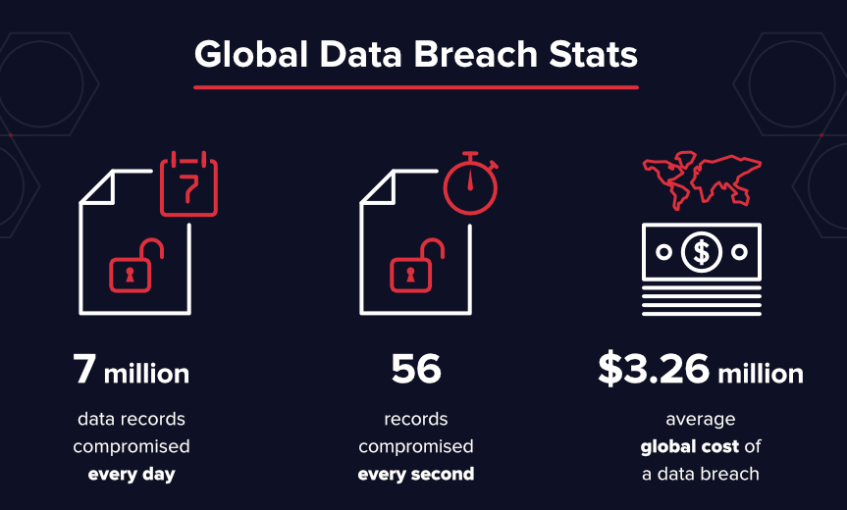
RESEARCH PROBLEM
Data Breach
Vulnerabilities in Current file management system
SQL Injection Attack
DDoS Attack
Theft / Stolen of the Files
IT20157814 | <<Ahmed M. N. H.>> | <<TMP-23-270>>

Slide 29
RESEARCH QUESTION
How can Implementing secure file management system to ensure confidentiality, integrity, and availability of the files, in blockchain based criminal information management system for Sri Lanka?
IT20157814 | <<Ahmed M. N. H.>> | <<TMP-23-270>>

Slide 30
RESEARCH GAP
 | Existing System (Manual/ Centralized System) | Secure File Management System in Decentralized Network
Confidentiality | Low | High
Integrity | Low | High
Availability | Low | High
IT20157814 | <<Ahmed M. N. H.>> | <<TMP-23-270>>

Slide 31
SPECIFIC OBJECTIVES
Propose Secure File Management System in Decentralized Network
To provide secure storage platform for criminal information management system
To ensure confidentiality, integrity, availability of the information
IT20157814 | <<Ahmed M. N. H.>> | <<TMP-23-270>>

Slide 32
SUB OBJECTIVES
Implementing cryptography secure file management system to share file
Implementing cryptography secure file management system to store file
IT20157814 | <<Ahmed M. N. H.>> | <<TMP-23-270>>

Slide 33
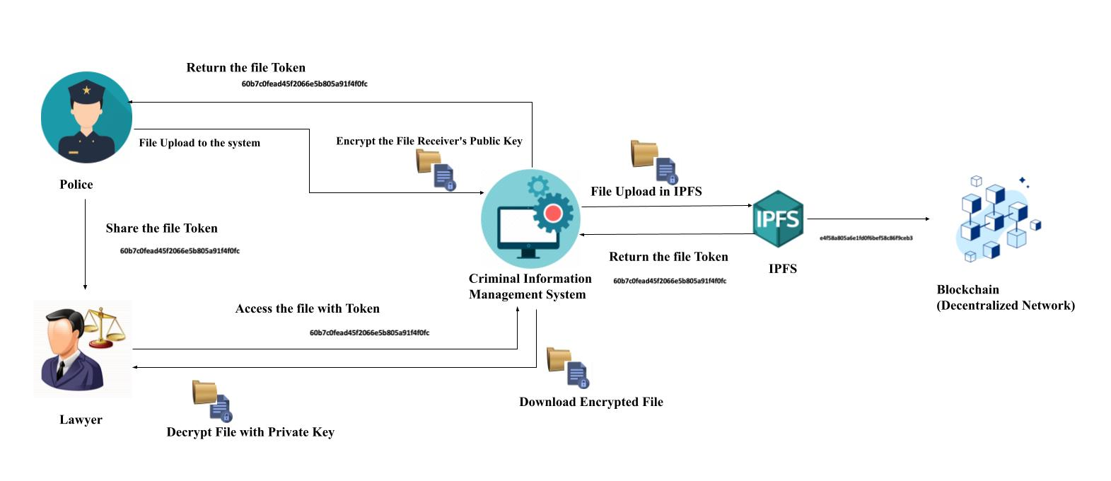
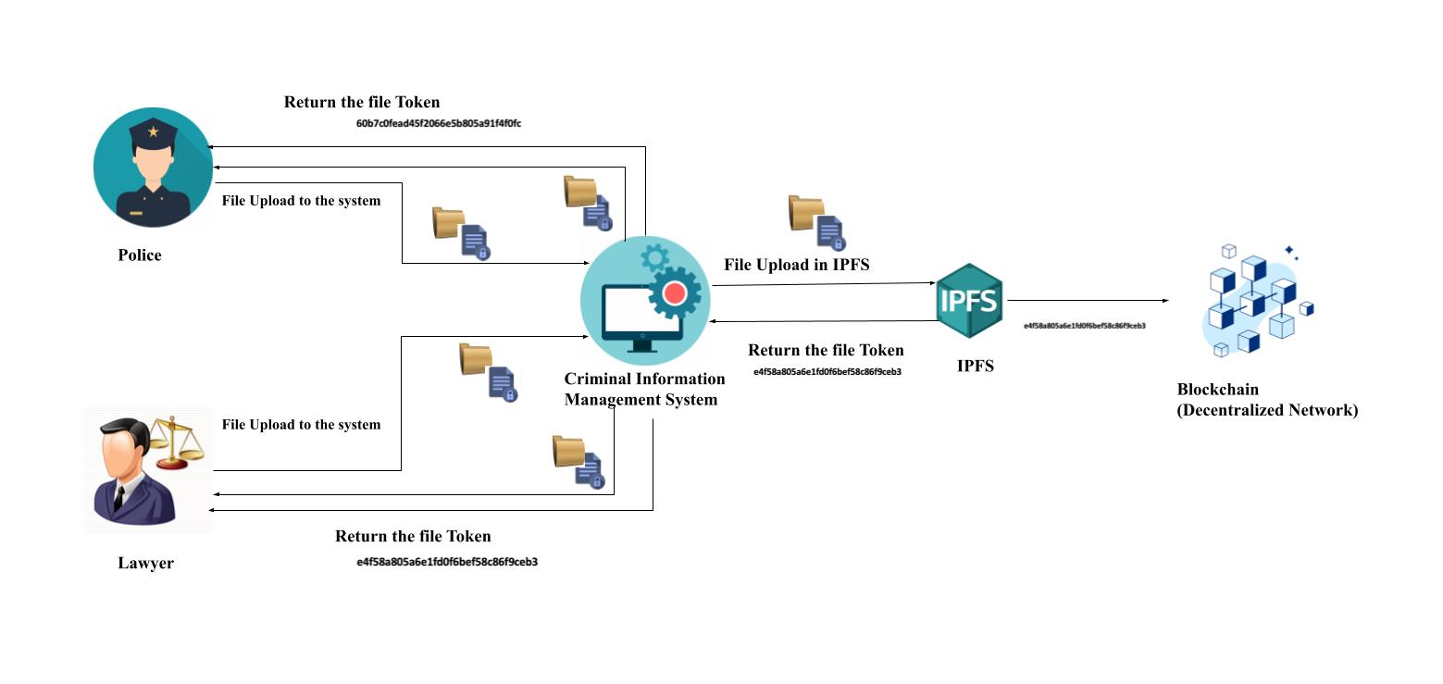
SYSTEM DIAGRAM
Implementing cryptography secure file management system to share file
2. Implementing cryptography secure file management system to store file
IT20157814 | <<Ahmed M. N. H.>> | <<TMP-23-270>>

Slide 34
METHODOLOGY
Implementing,
criminal information management system
Secure file management system
Additional layer with cryptography to secure file management
Integrating secure file management system with blockchain
IT20157814 | <<Ahmed M. N. H.>> | <<TMP-23-270>>

Slide 35
REFERENCES
IT20157814 | AHMED M. N. H.
E. Onuiri, A. Oludele, O. Olufunmike and S. Oluwawunmi , "A REAL-TIME CRIME RECORDS MANAGEMENT SYSTEM FOR NATIONAL SECURITY AGENCIES," May 2015. [Online]. Available: https://www.researchgate.net/publication/305426207_A_REAL-TIME_CRIME_RECORDS_MANAGEMENT_SYSTEM_FOR_NATIONAL_SECURITY_AGENCIES. [Accessed 20 March 2023].
A. Jain, S. Das, A. Singh Kushwah, T. Rajora and S. Saboo, "Blockchain-Based Criminal Record Database Management," 2021 Asian Conference on Innovation in Technology (ASIANCON), PUNE, India, 2021, pp. 1-5, doi: 10.1109/ASIANCON51346.2021.9544655.
S. Reno, S. Bhowmik and M. Ahmed, "Utilizing IPFS and Private Blockchain to Secure Forensic Information," 2021 International Conference on Automation, Control and Mechatronics for Industry 4.0 (ACMI), Rajshahi, Bangladesh, 2021, pp. 1-6, doi: 10.1109/ACMI53878.2021.9528180.
T.-S. C. J.-Y. W. Hsiao-Shan Huang, "A Secure File Sharing System Based on IPFS and Blockchain," 02 May 2022. [Online]. Available: https://arxiv.org/abs/2205.01728. [Accessed 20 March 2023]
D. Praveen, S. G. Totad, M. Rashinkar, R. Ostwal, S. Patil and P. M. Hadapad, "Scalable Blockchain Architecture using off-chain IPFS for Marks Card Validation," in 4th International Conference on Innovative Data Communication Technology and Application, 2022.

Slide 36

IT19983370 | THUSHITHARAN M.
Student’s Specialization - Cyber Security
IT19983370 | <<Thushitharan M.>> | <<TMP-23-270>>

Slide 37

INTRODUCTION
PERMISSION BASED ACCESS CONTROL FOR BLOCKCHAIN BASED SYSTEMS
Importance of access control.
Current access control methods following in Sri Lanka - Manual Paper-based
Current access control methods following internationally - Digitized but not a controlled access
Base idea behind this - Corruption prevention
IT19983370 | <<Thushitharan M.>> | <<TMP-23-270>>

Slide 38

RESEARCH PROBLEM
Corruption status in Sri Lanka
Corruption faced by the Department of Police Sri Lanka
Criminals contribution to the corruption
Consequences of the corruption
Corruption scenario and Explanation - If a criminal can corrupt an officer in the police department, that officer can destroy or manipulate the documents/records/evidences as per the criminal’s preference. No matter that he/she is a high level or low level officer.
IT19983370 | <<Thushitharan M.>> | <<TMP-23-270>>

Slide 39
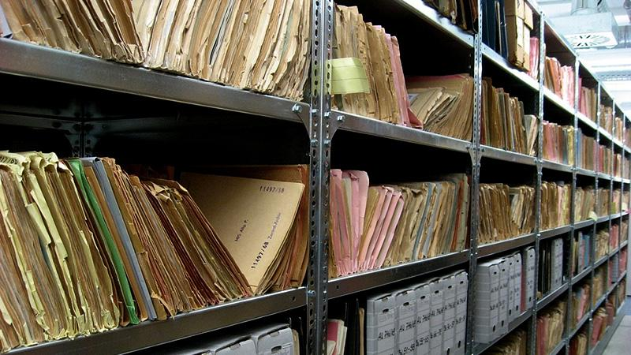
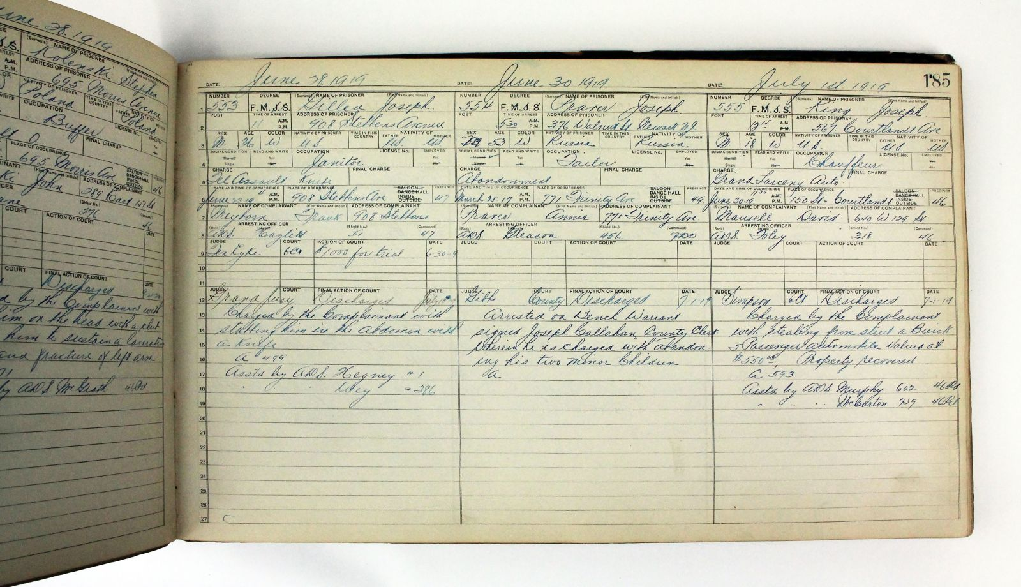
RESEARCH GAP
Existing Access control method in Sri Lanka and Internationally - Paper Based/uncontrolled access control/physical access control
Problems in existing access control
Anyone in the department can manipulate/delete the criminal/crime records
Anyone can add criminal records without verifying it, destroy the paper based evidences, destroy complaint letters/FIR files. This leads to integrity violation.
IT19983370 | <<Thushitharan M.>> | <<TMP-23-270>>

Slide 40
SPECIFIC OBJECTIVES
Propose a permission based Access control
To prevent access control violations, we are proposing a permission based access control.
This is using CRUD operations.
To ensure confidentiality, integrity.
Prevent corruption level within the department.
IT19983370 | <<Thushitharan M.>> | <<TMP-23-270>>

Slide 41
SUB OBJECTIVES
Implementing log monitoring facility.
Better and easy User Interface for admin dashboard
Reducing Physical storage by digitizing all paper works.
Generating Reports(crime, criminal)
IT19983370 | <<Thushitharan M.>> | <<TMP-23-270>>

Slide 42
METHODOLOGY
Defining Roles, Permissions
Grant/Revoke permissions
Implement Log monitoring system to monitor unauthorized access activities.
IT19983370 | <<Thushitharan M.>> | <<TMP-23-270>>

Slide 43
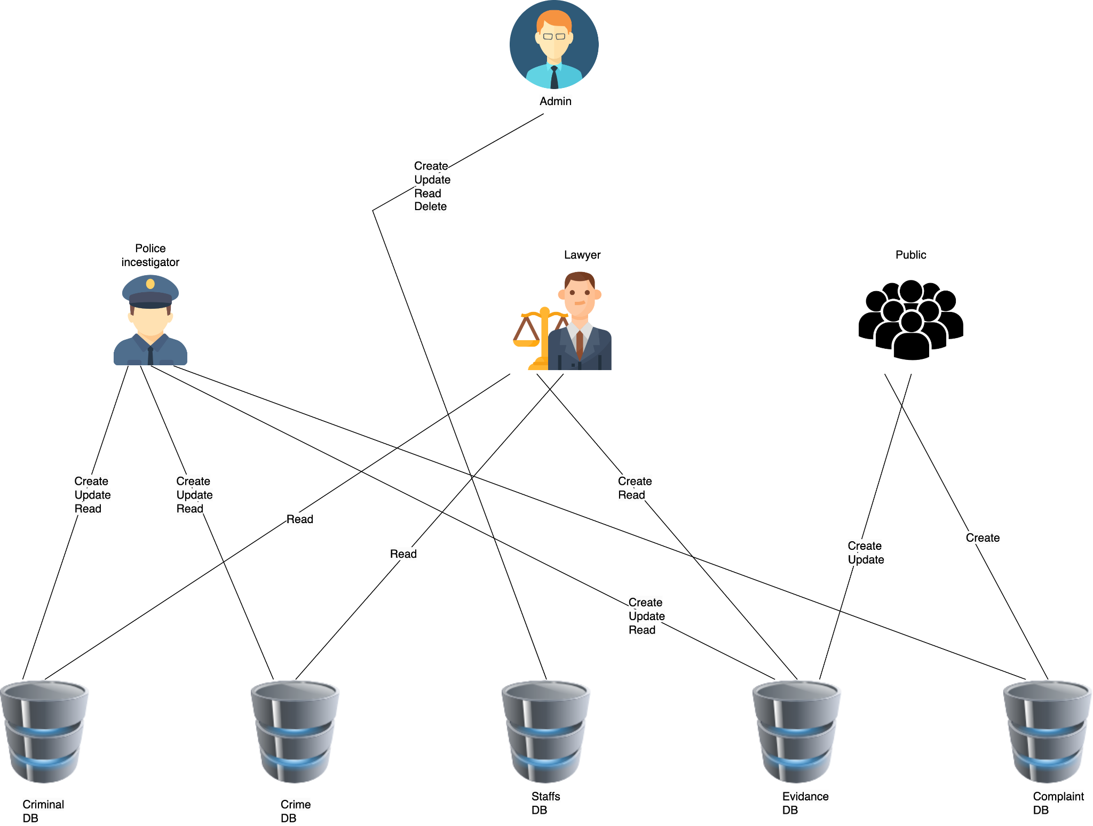
COMPONENT OVERVIEW DIAGRAM
IT19983370 | <<Thushitharan M.>> | <<TMP-23-270>>

Slide 44
REFERENCES
IT19983370 | THUSHITHARAN M.
Onuiri, Ernest & Oludele, Awodele & A, Olaore & O, Sowunmi & A., Ugo-Ezeaba. (2015). A REAL-TIME CRIME RECORDS MANAGEMENT SYSTEM FOR NATIONAL SECURITY AGENCIES. European Journal of Computer Science and Information Technology.
K. Yapa, A. N. Senaratne, R. P. D. T. D. Pathirathna, Y. P. C. N. Priyamantha, W. D. S. Dias and B. Katukithulgala, "Improve the Efficiency and Security by Digitalizing the Sri Lankan Police Department," 2021 3rd International Conference on Advancements in Computing (ICAC), Colombo, Sri Lanka, 2021, pp. 37-42, doi: 10.1109/ICAC54203.2021.9671175.
Cooray, N.A.C. and Weerasinghe, K.G.H.D. 2016. Crime Information Management System for Sri Lanka Police. 1st International Conference on Library and Information Management (ICLIM - 2016), 21st - 22nd October 2016, Department of Library and Information Science, Faculty of Social Sciences, University of Kelaniya, Sri Lanka. p 17-18.
IT19983370 | <<Thushitharan M.>> | <<TMP-23-270>>

Slide 45
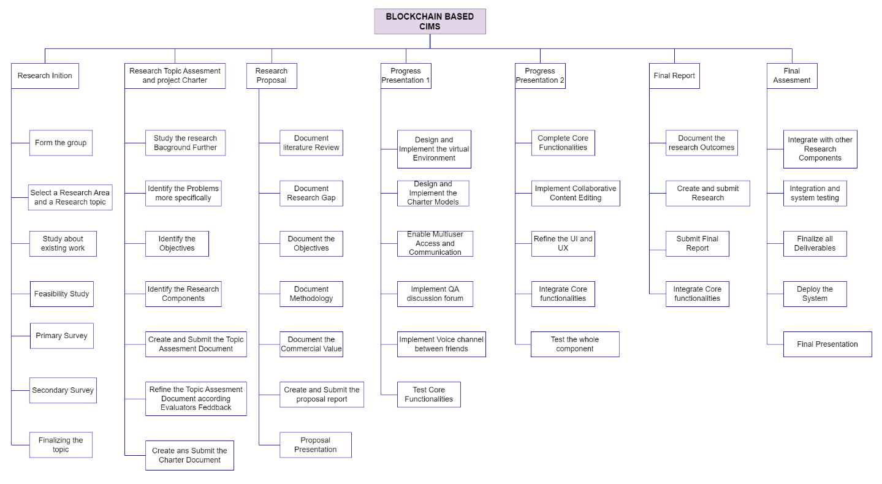
WORK BREAKDOWN FLOW

Slide 46

COMMERCIALIZATION
Target Market (Suitable market only)
Law enforcement agencies
Private investigators
Police department
Method Of Profit
Under our maintenance services.
Profit gain from Monthly charges.
Provide customer Support.

Slide 47
THANK YOU!
Project Details;
Project ID: TMP-23-270
Supervisor: Mr. Kanishka Yapa
Co-Supervisor: Ms. Dinithi Pandithage
Group Details;
IT20150952 - BRAHANAWARDHAN B.
IT20171438 - WIJAYARATHNE S. N.
IT20157814 - AHMED M. N. H.
IT19983370 - THUSHITHARAN M.

